Slide 1
Capstone Two Final Project
Predicting Shipment Delivery Outcomes
Sowmya Sree Kapula March 20, 2026

Slide 2
Problem Statement
The goal is to predict whether a shipment will arrive on time
Late deliveries increase operational costs and reduce customer satisfaction
A predictive model can help improve logistics planning and efficiency

Slide 3
Dataset Overview
Dataset includes shipment and customer information
Target variable: Reached.on.Time_Y.N
Includes features such as product cost, shipping details, and customer data
Data was cleaned and prepared for modeling

Slide 4
Data Preparation
Removed duplicates and handled missing values
Converted categorical variables using one-hot encoding
Split data into training and testing sets
Applied feature scaling where necessary

Slide 5

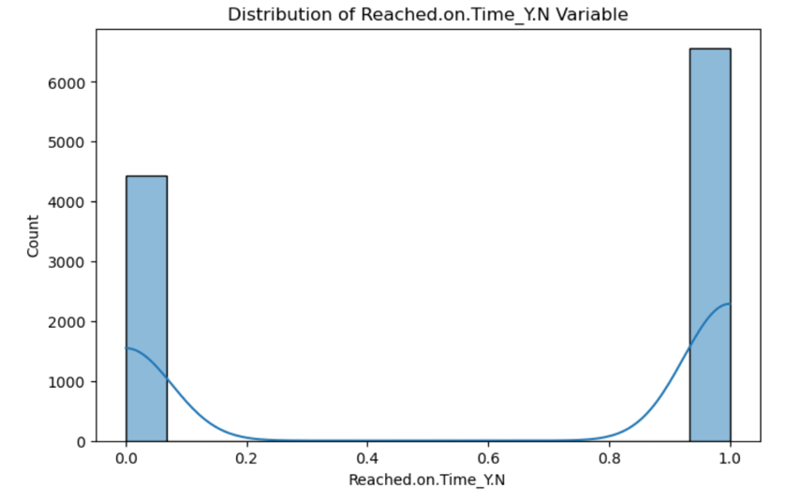
EXPLORATORY DATA ANALYSIS
Examined distribution of delivery outcomes
Identified relationships between features and target
Key visualizations:
Target distribution
Feature relationship (boxplot or heatmap)

Slide 6
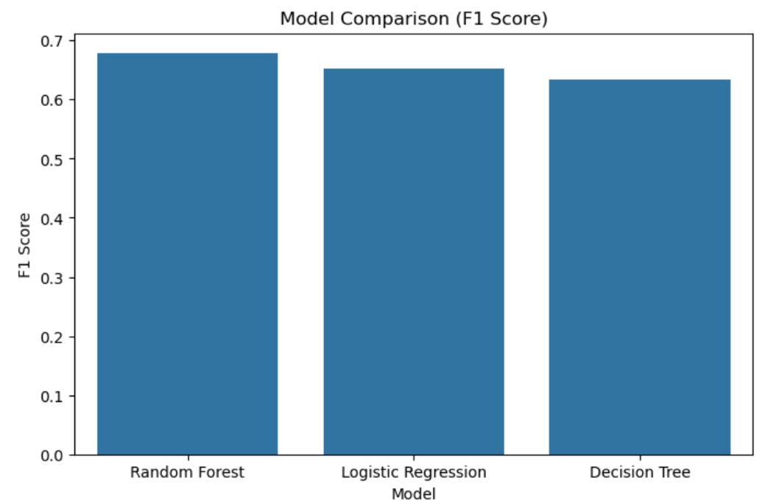
Models Evaluated
Logistic Regression
Decision Tree
Random Forest
Models were evaluated using:
Accuracy
Precision
Recall
F1 Score

Slide 7
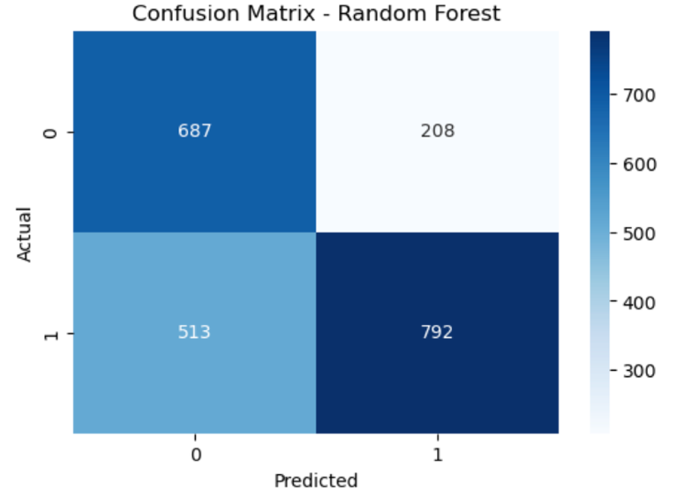
Final Model Selection
Random Forest performed best overall
Highest F1 score among all models
Provides strong balance between precision and recall
Key Metrics:
Accuracy: 0.68
F1 Score: 0.68
ROC AUC: 0.75

Slide 8
Recommendations
Focus on key factors influencing delivery performance
Use predictive modeling to improve logistics planning
Collect additional data (e.g., traffic, weather) to improve accuracy

Slide 9
Conclusion
Machine learning can effectively predict shipment outcomes
Random Forest provided the best performance
Future improvements can enhance model accuracy

